Slide 1
Lafayette College Health Professions Advising First Information Session
Professor Nancy McCreary Waters
Faculty Health Professions Advisor
Health Professions Advisory Committee (HPAC) Chair
Mrs Simona Glaus, Coordinator
Health Professions Program
Mrs Chelsea Emrick, Administrative Coordinator
CITLS/Health Professions Program/NCUR
21 August 2020

Slide 2
DDS or DMD? MD, DO, DPM? USMLE and MSTP? PT, OT, PA-C? COVID19? Feeling confused? You are not alone. The rapidly changing health professions landscape can make all of us feel a little like Dorothy and Toto…Or Captain America? Advice is everywhere… but good advice is hard to find... here is where it starts…

Slide 3
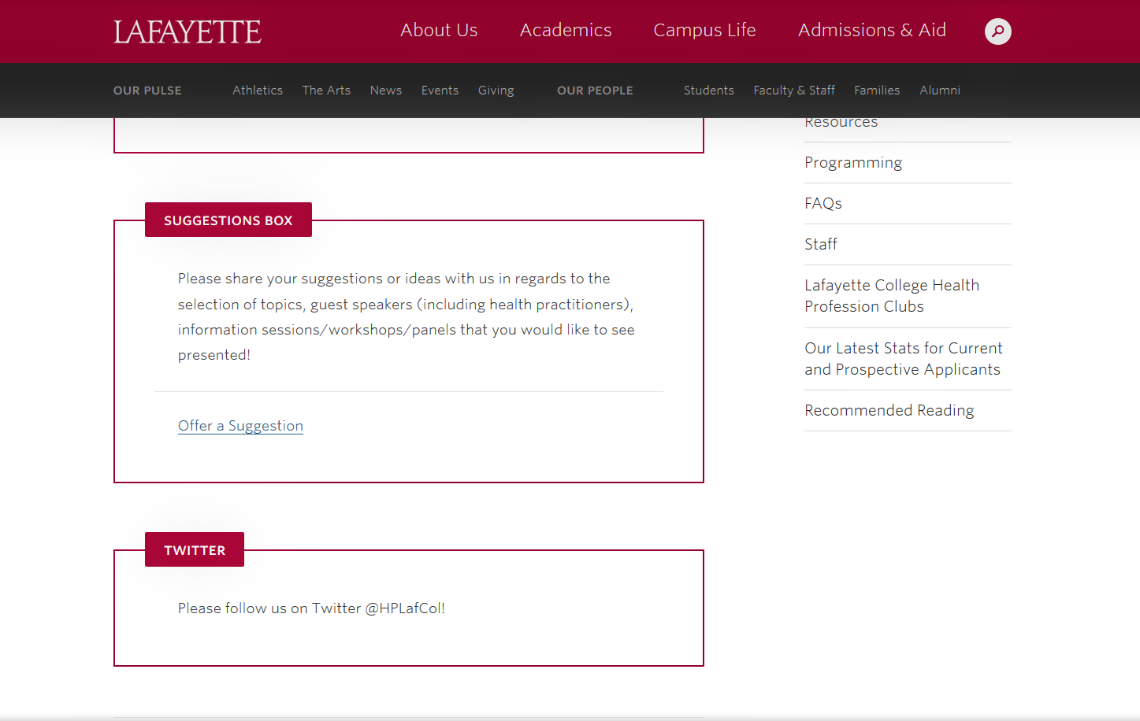
Before we forget… -Meet with your Academic Advisor -Spend time on the College Web Page -Sign onto healthprofessions@lafayette.edu -Offer an idea at the Suggestions box -Follow us on Twitter @HPLafCol -Check out GatewayCC -Log onto CareerSpot -Reply to GCC invite!

Slide 4
You Love it
You Are Great At Doing It
Passion
Mission
The World Needs it
Profession
Vocation
You Can Earn a Living At It
You Have Found Your Purpose!!!!

Slide 5
Today we will… -remind you about how advising works in the context of Lafayette College -review the steps you need to take to achieve your goal of a career in the health professions -direct your attention to upcoming events and resources that will help you! …and comment a bit about COVID19

Slide 6
Overarching Lafayette College Advising Principles… -Cultivate in you, our students, how to research and use available resources with independence to enable you to define your academic and personal goals. -Reinforce in our Lafayette students the value of our academic community: >intense curiosity >willingness to be challenged >assume responsibility for outcomes >openness to learning from others >commitment to academic integrity

Slide 7
Our purpose today… To provide guidance on steps critical to pursuit of a career in health professions…which are?? Medicinae Doctor (Allopathic MD) Osteopathic Medicine (DO) Dental Medicine & Surgery (DMD &DDS) Podiatric Medicine (DPM) Veterinary Medicines (DVM & VMD) Optometry (OD) …our HP Program and HPAC focus Nursing (RN, BSN, MSN) Nurse Practitioner (NP) Physician Assistant (PA, MPA) Physical/Occupational Therapist (PT, OT) Public Health Practitioners (MPH) Doctor of Pharmacy (PharmD) …with our Gateway Partners

Slide 8
HPAC?? Health Professions Advisory Committee faculty and staff appointed by the Provost to review student applications to medical, dental, optometry and veterinary schools HPAC: Chaired by Professor Waters, Biology, RISC 218 with 5 faculty from across campus to review and interview applicants Mrs Glaus, Coordinator of HP Programs, Scott Hall 101 Ms Schultz, Senior Associate Director, Gateway, Hogg 201 Mrs Emrick, Administrative Coordinator, Scott Hall 101 …all provide and coordinate programming for advising, career exploration, internships, externships, off-campus resources and more!

Slide 9
Health Professions Clubs (see OurCampus Portal) Lafayette College Against Cancer Lafayette Emergency Medical Services Pre-Dental Society Pre-Med Club …consider reactivating an existing club or contribute to leadership on a new student organization!

Slide 10
Undergraduate Preparation for Admission to Graduate
and Professional Schools in the Health Professions
Each school weights these criteria, but key to ALL are:
Academic/Science grades (major contributor)
Admissions tests (major contributor)
Health-related experiences
Research experiences
Community service and volunteer work
People skills & Humanist competencies
Letters of recommendation
HP school interview
COVID COMMENT: While some criteria will be more variable than others, ALL remain important to those making admissions decisions; you will need to SHOW your resilience and durability in the face of challenges!

Slide 11
Undergraduate Preparation – Academic coursework
Required Undergraduate Coursework
HP schools expect a STRONG NATURAL SCIENCE foundation, but you can graduate with any major and/or minor; follow your own intellectual and academic interests! Generally required:
1 Year EACH of:
Biology with labs (e.g., 111 & 112)
Physics with labs (e.g., 111 & 112; 131 & 132/133; 151 & 152)
Mathematics (e.g., 125 & 186, 161 & 186, 161 & 162 )
Writing-Intensive Coursework (e.g., FYS, English, “W” courses).
2+ Years of:
Chemistry with labs (GenChem121 & 122, Organic 221 & 222) and Biochem 350 or 361
Other frequently required courses:
Statistics, Psych 110, A&S 103, Phil 145
Specialty required courses:
Microbiology, Nutrition?, Anatomy & Physiology or equivalent
LOTS of other course options in natural and social science, humanities and engineering…explore them when/where you can!

Slide 12
Undergraduate Preparation – related considerations
Advanced Placement. AP Credit may sometimes be used to satisfy the Mathematics and English/writing requirements or recommended courses. But it should not generally be used to satisfy science requirements. HP schools want you to manage college-level science laboratory coursework in load.
If you accept AP credit in one of the sciences, you should take upper-level science courses with labs in the same science to satisfy the health professions school requirements. Individual schools will differ! COVID COMMENT: School scrutiny will rise! Be certain you are getting rigorous academic courses and laboratory training! Reduce/remove ambiguity in interpretations of your choices!
Summer School. If you major in social sciences or humanities, you may consider physics, biology or chemistry during the summer. BUT most HP schools PREFER completing all core science courses during the academic year…so you demonstrate your ability to handle laboratory classes in a full course load. Try not to make a habit of completing core courses in summer. If you do, be sure to be excellent!
Pass/Fail; 3 credit semesters. We discourage this. Particularly for a science or mathematics course! HP schools view your success in context, carrying a full load in a variety of disciplines. COVID COMMENT: P/F policies remain in flux; try to reduce ambiguity in your portfolio and elect full grading practice.
Study Abroad: Typically a PLUS, but plan coursework carefully in advance of registering. COVID COMMENT: Request transcripts EARLY!!!

Slide 13
Undergraduate Preparation – related considerations
Research: More than a PLUS—rapidly becoming essential for HP schools of all flavors. Find Independent Research, Honors Thesis Research, EXCEL work, but also CURE and innovative research experiences (TechClinic, Dyer Center).
Electives: Select meaningful, interesting coursework broadly, including courses in the arts and humanities. “what looks good to health professional schools” is flawed judgment. Get the most from your undergraduate education. It is who you are, how well-educated you are, where you have sought challenges, what you have learned from failures that will matter more than any given course completed.
Internships/Externships: Seek opportunities for health care involvement and shadowing, including volunteering at a hospital, shelter, clinic, with your personal physician, or a Lafayette alumnus/alumna in the health professions; make it active not passive observation! COVID COMMENT: Depth, Breadth, Passion, Dedication!
Extracurricular Activities: These hone people skills, demonstrate effective time management, develop leadership and collaborative skills, enhance communication abilities…especially coupled to long-term commitment …but NOT at the expense of your academic success! COVID COMMENT: Focus on what you control NOW!
…and Read! Widely! Especially on healthcare. On policy. On current events. On music, theatre, sports, literature… See the HP Program website for suggestions.

Slide 14
Evaluating the avalanche of applicants with..
Interpersonal competencies: Service orientation, Social Skill, Culturally aware, Teamwork, Oral communication. COVID COMMENT: Seek out activities for clinical engagement
Intrapersonal competencies: Ethical responsibility to self and others, Reliability and dependability, Resilience and adaptability, Capacity for improvement
Thinking and reasoning competencies: Critical thinking, Quantitative reasoning, Scientific inquiry, Written communication
Science competencies: Life systems, Human behavior

Slide 15
Pre-Professional Competencies from AAMC
Service Orientation: Demonstrates a desire to help others and sensitivity to others’ needs and feelings; demonstrates a desire to alleviate others’ distress; recognizes and acts on his/her responsibilities to society; locally, nationally, and globally.
Social Skills: Demonstrates an awareness of others’ needs, goals, feelings, and the ways that social and behavioral cues affect peoples’ interactions and behaviors; adjusts behaviors appropriately in response to these cues; treats others with respect.
Cultural Competence: Demonstrates knowledge of socio-cultural factors that affect interactions and behaviors; shows an appreciation and respect for multiple dimensions of diversity; recognizes and acts on the obligation to inform one’s own judgment; engages diverse and competing perspectives as a resource for learning, citizenship, and work; recognizes and appropriately addresses bias in themselves and others; interacts effectively with people from diverse backgrounds.
Teamwork: Works collaboratively with others to achieve shared goals; shares information and knowledge with others and provides feedback; puts team goals ahead of individual goals.
Oral Communication: Effectively conveys information to others using spoken words and sentences; listens effectively; recognizes potential communication barriers and adjusts approach or clarifies information as needed.
Ethical Responsibility to Self and Others: Behaves in an honest and ethical manner; cultivates personal and academic integrity; adheres to ethical principles and follows rules and procedures; resists peer pressure to engage in unethical behavior and encourages others to behave in honest and ethical ways; develops and demonstrates ethical and moral reasoning.
Reliability and Dependability: Consistently fulfills obligations in a timely and satisfactory manner; takes responsibility for personal actions and performance.
Resilience and Adaptability: Demonstrates tolerance of stressful or changing environments or situations and adapts effectively to them; is persistent, even under difficult situations; recovers from setbacks.
Capacity for Improvement: Sets goals for continuous improvement and for learning new concepts and skills; engages in reflective practice for improvement; solicits and responds appropriately to feedback.

Slide 16
Thinking, Reasoning and Science Competencies
Thinking and Reasoning Competencies
Critical Thinking: Uses logic and reasoning to identify the strengths and weaknesses of alternative solutions, conclusions, or approaches to problems.
Quantitative Reasoning: Applies quantitative reasoning and appropriate mathematics to describe or explain phenomena in the natural world.
Scientific Inquiry: Applies knowledge of the scientific process to integrate and synthesize information, solve problems and formulate research questions and hypotheses; is facile in the language of the sciences and uses it to participate in the discourse of science and explain how scientific knowledge is discovered and validated.
Written Communication: Effectively conveys information to others using written words and sentences.
Science Competencies
Living Systems: Applies knowledge and skill in the natural sciences to solve problems related to molecular and macro-systems including biomolecules, molecules, cells, and organs.
Human Behavior: Applies knowledge of the self, others, and social systems to solve problems related to the psychological, socio-cultural, and biological factors that influence health and well-being.

Slide 17
Academic Integrity and Conduct Violations
Practice Principles of Intellectual Honesty: Make judicious choices in your behavior! Assume the consequences of your actions!
Exhibit high personal standards of ethics and deportment. Exercise sound judgment. Students who lack high standards of character and integrity, either in academics (cheating, plagiarism) or in personal behavior (alcohol, drugs, vandalism, etc.) risk being eliminated as applicants… especially if they fail to own up to them!
The application process requires that the Dean of Advising report any disciplinary action to the HP schools where you seek admission. Problems arise when what is reported differs from what you disclose. Graduate schools also do background checks for off-campus violations. HP can help you contextualize your experiences.

Slide 18
…and another thing about conduct…
Etiquette and Manners Matter
Do YOUR homework first
Address persons with respect; use their titles
Treat e-mail as formal correspondence—faculty consider it to be so! Grammar and spelling matter!
Introduce yourself; Provide complete information (subject header? context? email signature? relevant attachments?)
Request, do not instruct
Provide sufficient advance notice
Always say ‘Thank you!’ and mean it!

Slide 19
Upcoming Events – watch website and email for details
Thursday 27 August 2020: Lafayette Student Involvement Fair, 10am, 5pm
Friday 28 August 2020: 2nd Year Health Professions Info Session, 12 noon
Monday 7 September 2020: Meet your Gateway CC Counselor notification!
Friday 11 September 2020: Unpacking AAMC’s VITA Tool, 12 noon
Saturday 12 September 2020: Tour4Diversity/AACOM Event, 12-6pm
Sunday 13 September 2020: AmMedicWomen’sAssn Conference, 12-3pm
Friday 18 September 2020: Summer Research Poster Session, 4-6pm
In September & October 2020: Gateway CC Meet Your Counselor Drop-In!
Wednesday 30 September 2020: Optometry School Virtual Fair, 9am-7pm
Wednesday 30 September 2020: AACP Pharmacy School Fair 10am-7pm
Wednesday 7 October 2020: Gateway CC Virtual Career Fair, 5-8pm
Thursday 15 October 2020: Gateway CC PharmaAlumni Panel, 12 noon
Saturday 17 October 2020: 6th Annual Health Professions Open House?
Student Club Events? We await the schedule—maybe YOU want to get involved to volunteer, engage, coordinate…lead???? ALL TIMES ET

Slide 20
Application Timeline Considerations
For most applicants (and especially for medical schools) , the optimal time to apply to HP graduate school is in spring/summer of senior year, or within a year of graduating…when you have amassed a competitive portfolio! The gap or growth year is now the ‘norm’ and convention for MD and DO schools, and many others including PA programs. COVID COMMENT: While this year’s applicant pool may constrict, next year is predicted to swell. Still, all applicants have experienced disruption. You are not alone!
If you are competitive enough to enroll in fall semester after graduating, you must complete your application in spring/summer of junior year.
HP Advising works with you when you have all the components in place: completed science requirements; Admissions Test (MCAT, DAT, OAT, or VCAT/GRE) on the horizon; a competitive profile of academic, research, health care experiences, extra-curricular accomplishments. Your application (letters of recommendation, HPAC interview, etc.) will occur in the spring semester of your application year…December to December to August matriculation!

Slide 22
What does EVERY aspiring HP student need?
External feedback that is
-compassionate
-informed
-constructive
Internal Self-Assessment that is
-courageously honest
Can I do, can I be better?

Slide 23
All of us at Lafayette College look forward to your success as you plan for a career in the health professions. Visit our web site at http://healthprofessions.lafayette.edu/ Follow our Twitter account @HPLafCol and connect with GateWay Career Center.
Register for and attend HP Advising and related events! Come when you are able, leave when you must…but make it a priority!

Slide 24
Virtual volunteering/service engagement ideas:
Focus Locally
Offer to cover childcare needs for neighbor
Be a phone fan or a pen pal for elderly
Consult your religious community and civic organizations
Review links such as idealist.org or volunteermatch.org
Check out “Nine ways to help others during the coronavirus pandemic”
Volunteer Virtually
Operation Warm has a list of 25 ways to volunteer virtually
Paper-airplanes.org provides online tutoring to support skill training for conflict-affected individuals
Dosomething.org volunteer online 9 ways for real impact

Slide 25
Useful Resources – explore our web site!
Pre-med:
Aspiring Docs (the AAMC’s Aspiring Docs website provides resources and inspiration to help pre-med students get started on their path to medicine)
the Premed Navigator (a monthly email that includes relevant information, resources, tools, tips, and important dates for pre-med students at every stage of their journey to medical school)
Aspiring Docs Diaries blog
Pre-dental:
ADEA GoDental (The ADEA GoDental website provides comprehensive resources to help prospective dental students get started on their path to dentistry)
ADEA GoDental Newsletter
ADEA Dental Blogs
Pre-vet:
The AAVMC’s portal (provides information, resources and tools to help pre-vet students get started on path to medicine
The Pathways Newsletter (the AAVMC’s monthly newsletter designed specifically for pre-vet students)
Pre-optometry:
The ASCO website (provides information and resources to help students get started on exploring a career in optometry)
ASCO’s Eye on Optometry blog (provides timely and useful information to anyone who is interested in applying to optometry school)

