Slide 1
Studying Abroad in the Health Professions
Daniel Kampsen M.Ed, J.D.
Assistant Director
Office of International & Off-Campus Education
Pardee 125
Kampsend@Lafayette.edu

Slide 2
Today’s Agenda
Why it is important
How you can leverage the experience
Timeline
General tips
Programs
Notes:
focuses on a Hmong refugee family who has just been forced to move from Laos—a country in Southeast Asia--to California. The mother of the family has her 14th child in a California hospital. This is the first time she’s given birth in a medical facility with the assistance of health professionals. The child ends up having an ongoing acute seizure issue. The family blames the hospital, as none of their other children have had this issue. The hospital works to provide medication for the child but the family would prefer to see a spiritual shaman as they aren’t convinced the issue is a medical one, but rather that it is a spiritual one. You can see where I’m going with this. The medical professionals didn’t understand or get to know the Hmong family’s cultural background, and the Hmong family had little understanding of the purpose of a modern medical facility. If you, as future health professionals, build a sense of cross-cultural competency through experiences such as studying abroad, you’ll be able to work more appropriately with people of different cultural backgrounds.

Slide 3
Why is it important?
Health professionals work with people of various cultures and language backgrounds
The language skills, cultural competencies and other skills you gain while studying abroad are in demand by 94% of employers.
Example: The Spirit Catches You and You Fall Down by Anne Fadiman
Notes:
focuses on a Hmong refugee family who has just been forced to move from Laos—a country in Southeast Asia--to California. The mother of the family has her 14th child in a California hospital. This is the first time she’s given birth in a medical facility with the assistance of health professionals. The child ends up having an ongoing acute seizure issue. The family blames the hospital, as none of their other children have had this issue. The hospital works to provide medication for the child but the family would prefer to see a spiritual shaman as they aren’t convinced the issue is a medical one, but rather that it is a spiritual one. You can see where I’m going with this. The medical professionals didn’t understand or get to know the Hmong family’s cultural background, and the Hmong family had little understanding of the purpose of a modern medical facility. If you, as future health professionals, build a sense of cross-cultural competency through experiences such as studying abroad, you’ll be able to work more appropriately with people of different cultural backgrounds.

Slide 4
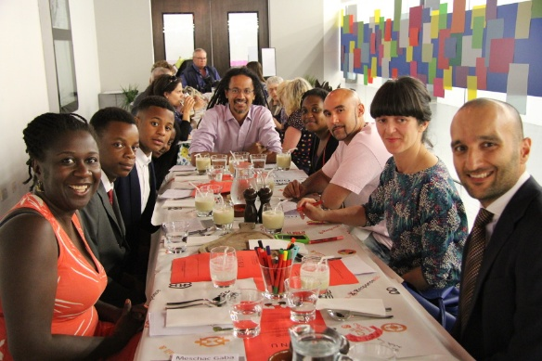
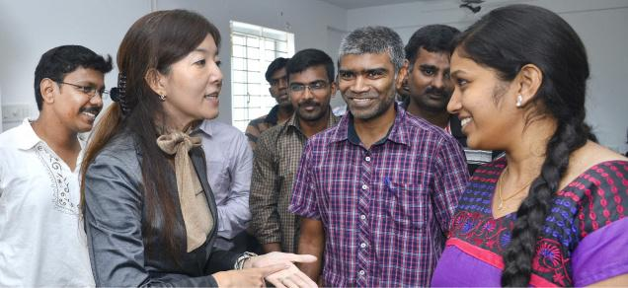
What can you do to get the most out of your study abroad experience?
Engage with the culture in an ACTIVE and REFLECTIVE way
Active: beyond observation, interact with people, work to understand the nuances, participate in cultural activities, travel within your host country, consider a homestay.
Reflective: Consider your experiences and relate them to your pre-study abroad outlook. HOW has your outlook changed, and WHY. If it hasn’t why not?
Notes:
It’s not enough to visit the famous monuments and sites of a country and take lots of pictures, although this can be one rewarding part of your study abroad experience. You will also need to actively interact with the people in your host country and strive to understand the nuances of that culture. Only active engagement with the culture will let you truly gain a cross-cultural competence
Every culture is different and it’s important that you continuously reflect on your study abroad experience so that you can think about HOW a cultural aspect or norm might be different from what you’re used to and WHY. There might be historical reasons, a common set of values or beliefs, a sign of respect, etc. You don’t have to adopt a culture at face value and make it your own necessarily, but you will want to work to understand it.

Slide 5
Timeline
Semester
Attend Get Started Session (schedule on website: goabroad.lafayette.edu, Getting Started, Get Started Sessions)
Schedule mandatory advising meeting (semester-long programs only)
Complete applications (2)
Lafayette deadline:
Spring: October 1
Fall: March 1
Program deadlines may vary
Interim
New programs will appear in June/July (interim.lafayette.edu)
Registration: mid-September (*This year, January 12)
Instructions on website

Slide 6
General Advice
Type of Courses
STEM Courses? CCS Requirements? Major/Minor Courses? Other Areas of Interest?
Type of Academic Experience
Island Program vs. Direct Enrollment vs. Hybrid vs. Extreme Hybrid
Type of Co-curricular Experience
Field placements, community involvement, extensive field trips?
Housing: homestay, residence hall, apartment, something unique?

Slide 7
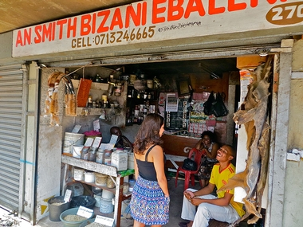
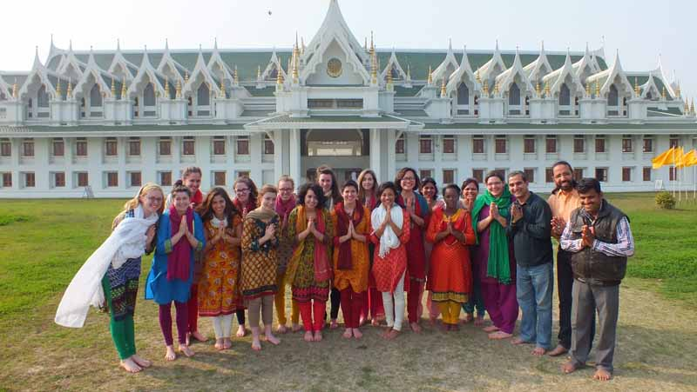
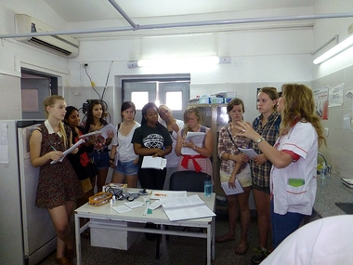
Health Professions Options
SIT: Global Health
SIT Features
Homestays, intensive subject matter focus, culminating research project or internship, VERY strong academic orientation
Multiple location options and terms
i.e. Argentina, Brazil, Chile, India, South Africa, Switzerland, Multi-Country
Curriculum
3-4 set courses (all courses on Global Health theme)
4th or 5th course: Independent study project or internship
Examples: challenges of diseases (TB, AIDS, etc.), health education, health financing, health care access

Slide 8
Health Professions Options
IES Chile – Health Studies in Santiago
Required Courses (2): Spanish for Healthcare Practitioners, Health Studies Seminar
Electives (3): community based learning courses, internship placements, courses in Bio, BioChem, Physics, Math, Humanities, Social Sciences.
Internship placements include: public health, health education, government, politics, etc.
Homestay or residence hall living

Slide 9
Health Professions Options
IFSA-Global and Public Health in India
Required: (1) Contemporary Indian Culture
Electives: pick 4 other courses
Indian Studies courses
Social Science and Humanities Courses
Global and public health courses include weekly field based practicums
Ayurveda and Indian Traditions of Healing, Environment and Occupational Health, Maternal and Child Health, Surveillance of Infectious Diseases, etc.

Slide 10
Health Professions Options
DIS (Denmark; Stockholm)
Tracks: medical practice & policy, biomedicine, neuroscience, public health
Required: one core class in track, most students will also take Danish/Swedish language & culture class
Electives: related to track or unrelated
Unrelated: humanities, economics, human rights, architecture, etc.
Highlights: hands-on fieldwork, study tours

Slide 11
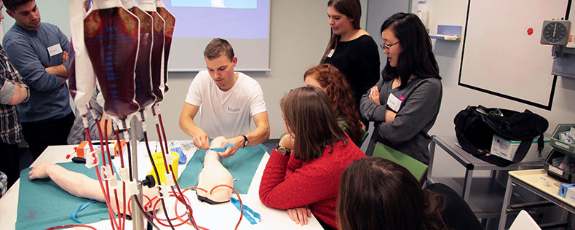
DIS: medical practice & policy student testimonial
“The experiences I had here in Copenhagen and the rest of Europe this semester have been valuable and life-altering. I got to learn about medicine from brilliant Danish doctors every day. When they weren’t teaching us about how to diagnose and treat disease, they were acting as role models, and giving us insight on what it is really like to work in medicine. On study tours, I talked to a patient with an artificial external heart in Germany, and observed in vitro fertilization procedures in Western Denmark.” – Jon Hanson, University of Minnesota

Slide 12
Health Professions Options
Other Possibilities
If you are able to take courses in Spanish: Spanish Studies Abroad Alicante/Seville, IES Granada
If you are able to take courses in French: IES Nantes
For English Speakers: IFSA England, Scotland and Ireland; IES Amsterdam; IFSA Australia and New Zealand

Slide 13
Health Professions Options
Lafayette: Healthcare in London (summer)
Runs every other summer
8 weeks, 2 Lafayette credits
3 weeks of class, 4 weeks of interning, 1 week of class
Internship area examples: brain/cognitive development, mental health, health education, maternal health

Slide 14
Contact information
Daniel Kampsen: Kampsend@Lafayette.edu

Slide 15
Questions?

