Slide 1
Lafayette College Health Professions Advising Sophomore Information Session
Professor Nancy McCreary Waters
Faculty Health Professions Advisor; Health Professions Advisory Committee (HPAC) Chair
Ms Simona Glaus, Director
Health Professions Program
Ms Sue Herschlag, Administrative Coordinator
Health Professions Program
13 September 2023

Slide 2
Before we forget…PLEASE SIGN IN FOR TODAY’S PROGRAM on the sign in sheets provided! Thank you!

Slide 3
How important are Health Professions?
The US Bureau of Labor Statistics indicates that the health care industry is one of the fastest growing sectors, accounting for 14% of all US workers, 19+ million jobs.
Concurrently, the US Department of Commerce reports that total health care spending exceeds 18.3% of GDP (up from 17% nearly 2 years ago).
Consider the 100 largest companies in the US and ~3/4 of them (including Google, Microsoft, Intel and WalMart) are actively involved in the health care industry in some manner.

Slide 4
But where are the real needs?
Medically Underserved Areas and Health Professional Shortage Areas are projected to increase, as 4 of 50 states received failing grades in 2021, but anticipating 23 of 50 states by 2030.
Staff shortages in nursing plus all other areas of health care teams demand hospitals take as many as 25% or more of beds offline; hospital closures and consolidations leave communities at risk of no hospital within 75 miles.
Overall 2.78 physicians/1000 in the US (2.9 2 years ago; 77/1000 in Qatar)
MUA are predominantly rural communities and urban inner city communities, where lack of 1⁰ care physicians place millions at risk.
1⁰ care physicians number 39.8/100,000 in rural areas compared to 53.3/100,000 in urban areas.
Rural healthcare physician crisis? While 19+% of Americans live in rural areas, only 10% of physicians practice there.
Currently 2 of 5 practicing physicians will be 65+ in the next decade.
Overall physician shortages? Model projections for 2032 show a shortfall of between 54,100 and 139,000 physicians, just to meet current, already inequitable health care utilization patterns!

Slide 5
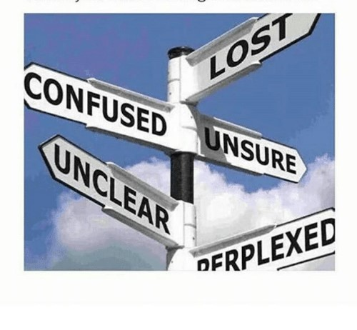
DDS or DMD? MD, DO, DPM? USMLE? MSTP? PT, OT, NP, PA-C? MPH? PharmD?...maybe you feel a little
Advice is all around, but good advice? It could be hard to find, but not for YOU because YOU are HERE…

Slide 6
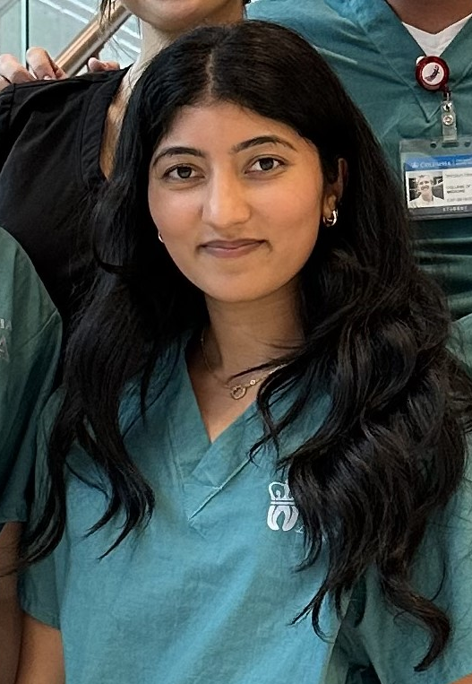
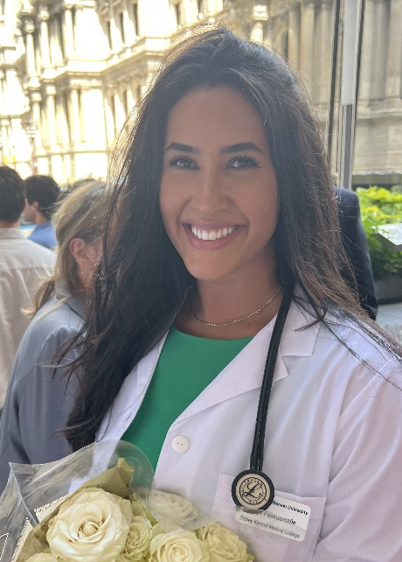
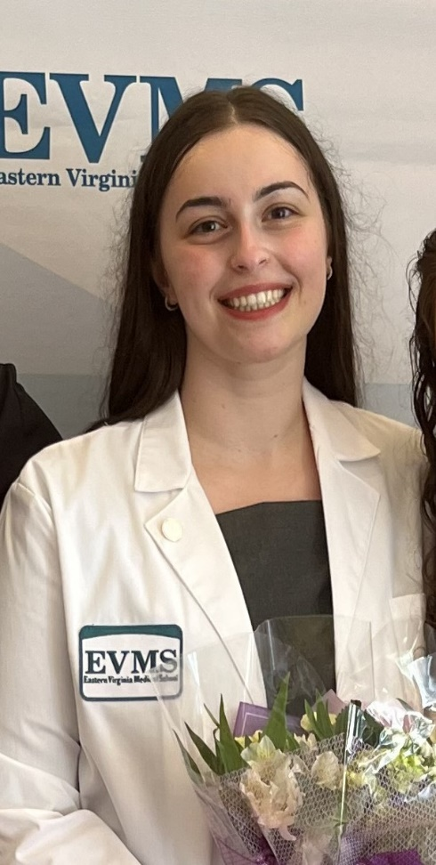
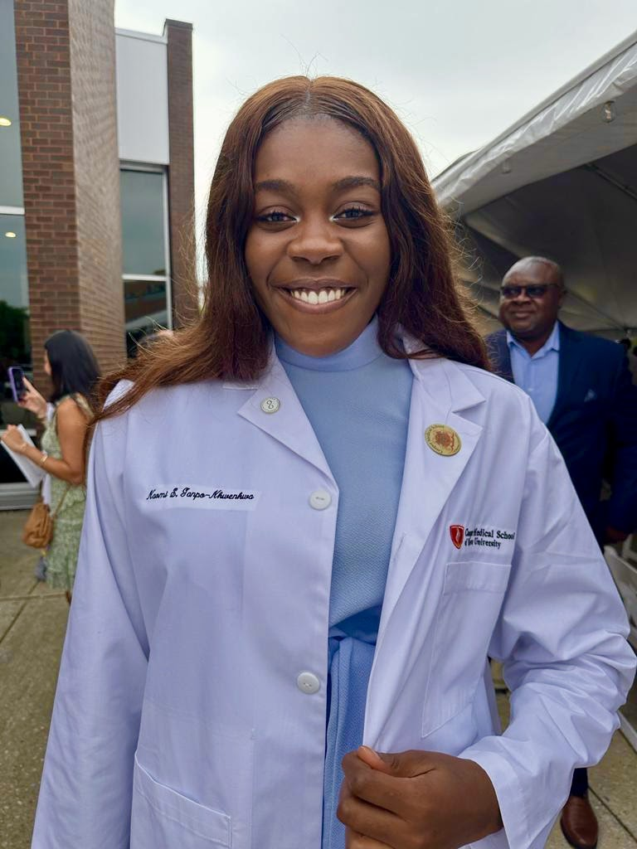
Seeing your future: Know your WHY!

Slide 7
KNOW YOUR WHY!
Each of your decisions can eliminate some possibilities, but each may also lead to new opportunities. Make choices that reflect and demonstrate why they are valuable to you. The best thing to do is that for which we have the best reasons. Be sure your reasons are authentic, rooted in knowledge, and are well-conceived!

Slide 8
Today we will… refresh your memory about how advising works in the context of Lafayette College provide overview of where you should be at this stage in the steps you are taking to seek a career in the health professions direct your attention to upcoming events and resources that will help you!

Slide 9
Before we forget… >Engage with your Academic Advisor >Peruse the College Web Page, DegreeWorks, and Lafayette Today >READ OUR emails: healthprofessions@lafayette.edu >Follow us on Twitter @HPLafCol >Stay up on GatewayCC

Slide 10
Health Professions Clubs can play a meaningful role in your career! Lafayette College Against Cancer Lafayette Emergency Medical Services Pre-Dental Society Pre-Health Professions Society …and more! Become an active participant and contribute to leadership! Meet your club leadership! Be engaged!

Slide 11
Overarching Lafayette College Advising Principles… Cultivate in you, our students, how to research and use available resources independently to enable you to define your academic and personal goals. Reinforce in our Lafayette students the values of our academic community: >intense curiosity >willingness to be challenged >assume responsibility for outcomes >openness to learning from others >commitment to academic integrity

Slide 12
Our guidance continues for… Medicinae Doctor (Allopathic MD) Osteopathic Medicine (DO) Dental Medicine & Surgery (DMD &DDS) Podiatric Medicine (DPM) Veterinary Medicines (DVM & VMD) Optometry (OD) …our HP Program and HPAC focus Physician Assistant (PA, MPA) Physical/Occupational Therapist (PT, OT) Public Health Practitioners (MPH) Doctor of Pharmacy (PharmD) Nursing (RN, BSN, MSN) Nurse Practitioner (NP)…with our Gateway Partners

Slide 13
HP Advising is supported by HPAC: The Health Professions Advisory Committee, faculty and staff from across campus who review student applications to medical, dental, optometry and veterinary schools; interview and offer CLoE evaluations about applicants to schools! Dr Waters, HPAC Chair, Faculty Health Professions Advisor RISC 218 watersn@lafayette.edu Ms Glaus, Director, Health Professions Program Scott Hall 101 glauss@lafayette.edu Ms Schultz, Director, Strategic Project, Gateway CC Hogg Hall 201schultzm@lafayette.edu …collectively HP Advising and Gateway Career Center offer sources of programming for advising, career exploration, internships, externships, off-campus resources and more! Plan to access and use these resources!

Slide 14
Consider your Timeline
1 20 40 60 80
1 2 3 4 5 6 7 8
4 years, 8 semesters, that shape your future!
What will yours look like??
What will YOU look like?
What do you expect from your education at Lafayette?
Notes:
As the commercial says, “This isn’t your father’s Oldsmobile…” or your mother’s allopathic degree or your uncle’s MD/PhD program or your brother’s internal medicine career. The Health Professions Advising Office works with you to provide programming and feedback to enable you to maximize your chances for success in your chosen career as a health professional. Want to get an overview of the process and discuss our approach? You are in the right place

Slide 15
Undergraduate Preparation for Admission to Graduate
and Professional Schools in the Health Professions
You KNOW each school has its own criteria, but key to all are:
Academic/Science grades (major contributor)
Admissions tests (major contributor)
Health-related experiences
Research experiences
Community service and volunteer work
People skills & Humanist competencies
Letters of recommendation
HP school interview
While some criteria will be more variable than others, ALL remain important to those making admissions decisions; you will need to SHOW and provide EVIDENCE of your resilience and durability in the face of challenges!

Slide 16
Undergraduate Preparation – Academic coursework
Required Undergraduate Coursework Check your bellwether schools
HP schools expect a STRONG NATURAL SCIENCE foundation, but you can graduate with any major and/or minor; follow your own intellectual and academic interests! Required or strongly encouraged courses:
1 Year EACH of:
Biology with labs (e.g., 111/112)
Physics with labs (e.g., 111/112; 131 & 132/133; 151 & 152)
Mathematics/Calculus/Statistics; minimally 1 calc + 1 stats
English composition/Writing-Intensive coursework
2+ Years of:
Chemistry with labs (Chem 107/108, Ochem 221/222) and Survey of Biochemistry (Chem)351
Other frequently required or specialty courses:
Sociology, Psychology, Bioethics, Microbiology, Nutrition, Genetics, Anatomy & Physiology or equivalent
~12-14 Core Courses needed; 1st semester sophomores should be targeting completion of ~6-8 courses to stay on track
EXPLORE course options in natural science, social science, humanities, and engineering divisions wherever possible!

Slide 17
Undergraduate Preparation – related considerations
Advanced Placement. AP Credit may sometimes be used to satisfy the Mathematics and English/writing requirements or recommended courses. But it should not generally be used to satisfy science requirements. HP schools want you to manage college-level science laboratory coursework in load.
If you accept AP credit in one of the sciences, you should take upper-level science courses with labs in the same science to satisfy the health professions school requirements. Individual schools will differ! School scrutiny remains high due to the pandemic. Be certain you are getting rigorous academic courses and laboratory training! Reduce/remove ambiguity in interpretations of your choices!
Summer School. If you major in social sciences or humanities, you may consider doing physics, biology or chemistry during the summer. BUT most HP schools PREFER completing all core science courses during the academic year…so you demonstrate your ability to handle laboratory classes in a full course load. Avoid a habit of completing core courses in summer. If you do, be sure to be excellent!
Pass/Fail; 3 credit semesters. We discourage this. Particularly for a science or mathematics course! HP schools view your success in context, carrying a full load in a variety of disciplines. P/F policies vary, try to reduce ambiguity in your portfolio and elect full grading practice.
Study Abroad: Typically a PLUS, but plan coursework carefully in advance of registering. Request transcripts EARLY!!!

Slide 18
Undergraduate Preparation – related considerations
Research: More than a PLUS—rapidly becoming essential for HP schools of all flavors. Find Independent Research, Honors Thesis Research, EXCEL work, but also CURE and innovative research experiences (TechClinic, Dyer Center).
Electives: Select meaningful, interesting coursework broadly, including courses in the arts and humanities. “what looks good to health professional schools” is flawed judgment. Get the most from your undergraduate education. It is who you are, how well-educated you are, where you have sought challenges, what you have learned from failures that will matter more than any given course completed.
Internships/Externships: Seek opportunities for health care involvement and shadowing, including volunteering at a hospital, shelter, clinic, with your personal physician, or a Lafayette alumnus/alumna in the health professions; make it active not passive observation! Demonstrate Depth, Breadth, Passion, Dedication!
Extracurricular Activities: These hone people skills, demonstrate effective time management, develop leadership and collaborative skills, enhance communication abilities…especially coupled to long-term commitment …but NOT at the expense of your academic success! Focus on what you control NOW!
…and Read! Widely! Especially on healthcare. On policy. On current events. On music, theatre, sports, literature… See the HP Program website for suggestions.

Slide 19
UNIVERSAL Pre-Professional Competencies
Service Orientation: Demonstrates a desire to help others and sensitivity to others’ needs and feelings; demonstrates a desire to alleviate others’ distress; recognizes and acts on his/her responsibilities to society; locally, nationally, and globally.
Social Skills: Demonstrates an awareness of others’ needs, goals, feelings, and the ways that social and behavioral cues affect peoples’ interactions and behaviors; adjusts behaviors appropriately in response to these cues; treats others with respect.
Cultural Competence: Demonstrates knowledge of socio-cultural factors that affect interactions and behaviors; shows an appreciation and respect for multiple dimensions of diversity; recognizes and acts on the obligation to inform one’s own judgment; engages diverse and competing perspectives as a resource for learning, citizenship, and work; recognizes and appropriately addresses bias in themselves and others; interacts effectively with people from diverse backgrounds.
Teamwork: Works collaboratively with others to achieve shared goals; shares information and knowledge with others and provides feedback; puts team goals ahead of individual goals.
Oral Communication: Effectively conveys information to others using spoken words and sentences; listens effectively; recognizes potential communication barriers and adjusts approach or clarifies information as needed.
Ethical Responsibility to Self and Others: Behaves in an honest and ethical manner; cultivates personal and academic integrity; adheres to ethical principles and follows rules and procedures; resists peer pressure to engage in unethical behavior and encourages others to behave in honest and ethical ways; develops and demonstrates ethical and moral reasoning.
Reliability and Dependability: Consistently fulfills obligations in a timely and satisfactory manner; takes responsibility for personal actions and performance.
Resilience and Adaptability: Demonstrates tolerance of stressful or changing environments or situations and adapts effectively to them; persists even under difficult situations; recovers from setbacks.
Capacity for Improvement: Sets goals for continuous improvement and for learning new concepts and skills; engages in reflective practice for improvement; solicits and responds appropriately to feedback.

Slide 20
UNIVERSAL Pre-Professional Competencies
Service Orientation: Demonstrates a desire to help others and sensitivity to others’ needs and feelings; demonstrates a desire to alleviate others’ distress; recognizes and acts on his/her responsibilities to society; locally, nationally, and globally.
Social Skills: Demonstrates an awareness of others’ needs, goals, feelings, and the ways that social and behavioral cues affect peoples’ interactions and behaviors; adjusts behaviors appropriately in response to these cues; treats others with respect.
Cultural Competence: Demonstrates knowledge of socio-cultural factors that affect interactions and behaviors; shows an appreciation and respect for multiple dimensions of diversity; recognizes and acts on the obligation to inform one’s own judgment; engages diverse and competing perspectives as a resource for learning, citizenship, and work; recognizes and appropriately addresses bias in themselves and others; interacts effectively with people from diverse backgrounds.
Teamwork: Works collaboratively with others to achieve shared goals; shares information and knowledge with others and provides feedback; puts team goals ahead of individual goals.
Oral Communication: Effectively conveys information to others using spoken words and sentences; listens effectively; recognizes potential communication barriers and adjusts approach or clarifies information as needed.
Ethical Responsibility to Self and Others: Behaves in an honest and ethical manner; cultivates personal and academic integrity; adheres to ethical principles and follows rules and procedures; resists peer pressure to engage in unethical behavior and encourages others to behave in honest and ethical ways; develops and demonstrates ethical and moral reasoning.
Reliability and Dependability: Consistently fulfills obligations in a timely and satisfactory manner; takes responsibility for personal actions and performance.
Resilience and Adaptability: Demonstrates tolerance of stressful or changing environments or situations and adapts effectively to them; persists even under difficult situations; recovers from setbacks.
Capacity for Improvement: Sets goals for continuous improvement and for learning new concepts and skills; engages in reflective practice for improvement; solicits and responds appropriately to feedback.
Anatomy of an Applicant Guide! A GREAT AAMC resource with developmental planning worksheets you can use to gauge your performance! Click here!

Slide 21
Evaluating the avalanche of applicants with..
Interpersonal competencies: Service orientation, Social Skill, Culturally aware, Teamwork, Oral communication. COVID COMMENT: Seek out activities for clinical engagement
Intrapersonal competencies: Ethical responsibility to self and others, Reliability and dependability, Resilience and adaptability, Capacity for improvement
Thinking and reasoning competencies: Critical thinking, Quantitative reasoning, Scientific inquiry, Written communication
Science competencies: Life systems, Human behavior

Slide 22
Academic Integrity and Conduct Violations
Practice Principles of Intellectual Honesty: Make judicious choices in your behavior! Assume the consequences of your actions!
Exhibit high personal standards of ethics and deportment. Exercise sound judgment. Students who lack high standards of character and integrity, either in academics (cheating, plagiarism) or in personal behavior (alcohol, drugs, vandalism, etc.) risk being eliminated as applicants… especially if they fail to own up to them!
The application process requires that the Dean of Advising report any disciplinary action to the HP schools where you seek admission. Problems arise when what is reported differs from what you disclose. Graduate schools also do background checks for off-campus violations. HP can help you contextualize your experiences.

Slide 23
…and another thing about conduct…
Etiquette and Manners Matter
Do YOUR homework first. sometimes it does hurt to ask!
Address persons with respect; use their titles.
Treat e-mail as formal correspondence—faculty and practitioners treat it as such! Grammar and spelling matter!
Introduce yourself; Provide complete information, specific context (subject header? context? email signature? relevant attachments?)
Request, rather than demand or instruct.
Provide sufficient advance notice.
Always say ‘Thank you!’ and mean it!

Slide 24
Upcoming Events – watch website and email for details
Sept 13: 2nd Year Session HPA Info Session, 12-1pm, Hugel 100
Sept 20: Gateway CC Career Fair ON CAMPUS, 5-8pm
Sept 20: AACP Virtual Pharmacy School Fair, 10am-7pm
Sept 27: 9th Annual, 4th VIRTUAL Homecoming HP Open House, 7-8pm
Oct 17, 18: AAMC VIRTUAL Med School Fair
Watch for: Student Club Events? Gateway Career Center programs? Life Sciences and Industry week? Virtual Fairs?
Prepare for: HPA BlueSheet Advising Sessions!
New! Small Group shared collective insight and feedback!

Slide 26
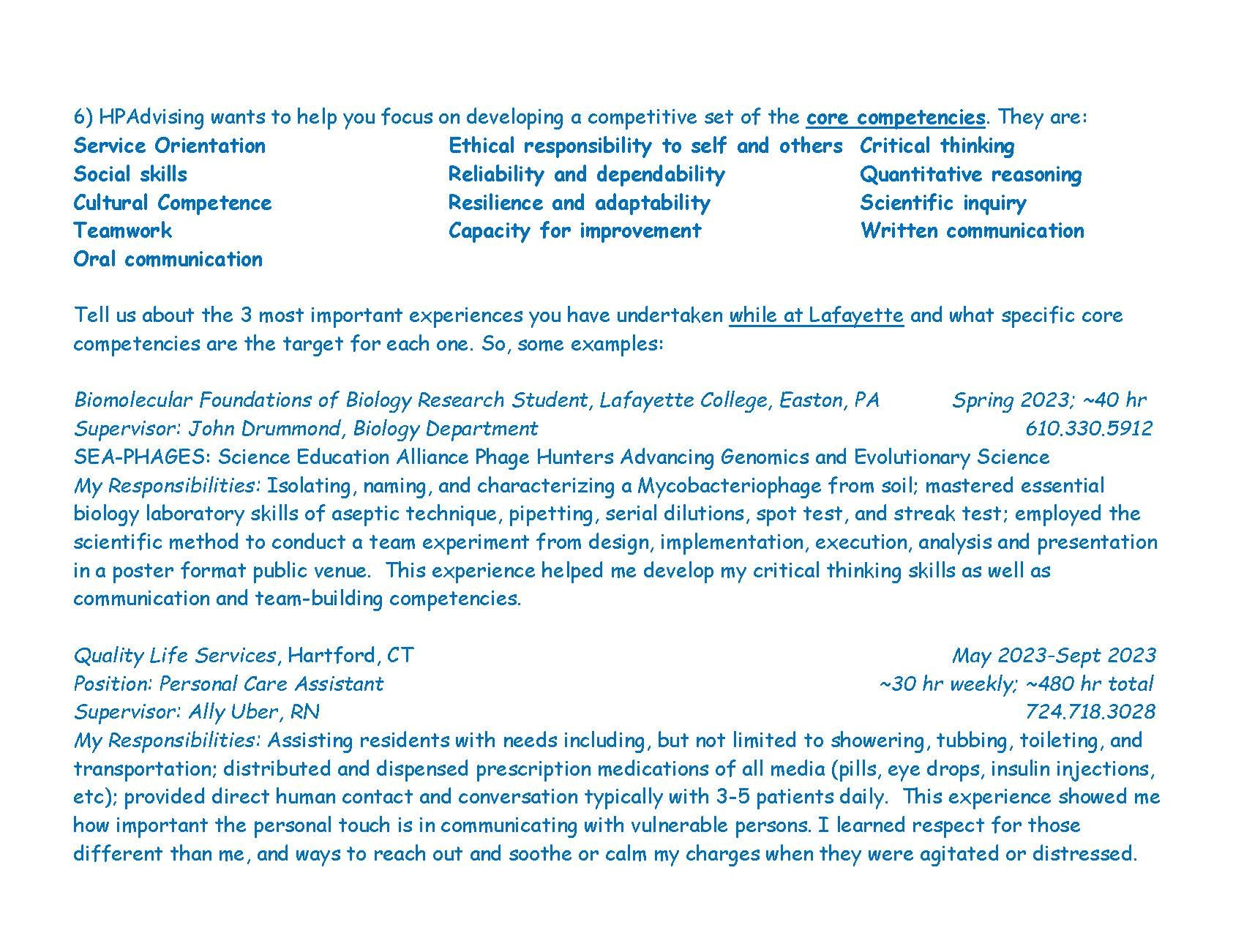

Slide 27
How does this all fit together?
Academic credentials and course choices (AA)
Shadowing, clinical engagement, experiences (GCC)
Resources, organization, HPAC & application guidance (HPA)
Your complete, competitive portfolio, ready to apply!

Slide 28
Application Timeline Considerations
Our HP website timeline resource
For most applicants (and especially for medical schools) , the optimal time to apply to HP graduate school is in spring/summer of senior year, or within a year of graduating. This enables you to have amassed a competitive portfolio! The gap or growth year is now the ‘norm’ for MD and DO schools, PA programs and others. This poses added challenge for international student applicants. The smaller pool originally predicted with pandemic actually expanded by ~25% nationally. The most recent cycle shows a more typical application increase. Your disruptions are shared! You are not alone!
If your portfolio is competitive enough you must complete your application in spring/summer of junior year to enroll in the fall following graduation.
HP Advising works with you when you have all the components in place: completed science requirements; Admissions Test (MCAT, DAT, OAT, or VMCAT/GRE) on the horizon; a competitive profile of academic, research, health care experiences, extra-curricular accomplishments. Your application (letters of recommendation, HPAC interview, CLoE, etc.) will occur in spring semester of your application year…December to December to August matriculation! Schools are increasingly emphasizing completion of all core academic requirements before applying! Not just by matriculation!

Slide 29
How do you assess your readiness? Who is your comparison group? Keep these most recent national data in view!!
Allopathic medical schools admitted 22,712 of their 55,188 applicants (41.2%); osteopathic schools admitted 5,750 out of 23,000+ applicants (25%)
The 68 US dental schools admitted 6,327 of the 11,180 who applied (57%)
The 48 US/International veterinary schools admitted 3,860 of 10,811 applicants (35.7%)
The 23 US optometry schools admitted 1,954 from the 2,700 who applied (72.4%)
The 11 colleges of podiatry admitted 531 from their 716 applicants (74.2%)
The 260 PA programs admitted 12,035 from the 30,137 applicants (39.9%)

Slide 30
Understanding Holistic Review
Advanced by DO Schools, HR gained traction when MD schools sought to broaden access to medical school; now widely touted.
Useful in ‘first cut’ review for deciding/considering interview offers, HR places credentials of applicants contextually to life experiences; it insures applicants meet the school’s mission.
HR is NOT ‘robbing Peter to pay Paul’ nor ‘using an overflowing bucket to fill an empty bucket’…strong performance in some areas will NOT mitigate weak performance elsewhere.
“No one is saying that skills and inclination in science are not important,” Dr. Witzburg said. “But in this rapidly evolving and diverse society, they alone are insufficient.”
“I have a really strong application, except for ________.” Do not fall into this trap and fallacy! Plan NOW with attention to your choices!

Slide 31
What does EVERY aspiring HP student need?
External feedback that is
-compassionate
-informed
-constructive
Internal Self-Assessment that is
-courageously honest
Can I do, can I be better?

Slide 32
How do you seek HPA assistance as a sophomore HPStudent?
Email your specific question and request; notify HPA, Ms Glaus & Prof Waters; plan ahead and provide 3-5 business days
Avail yourself during registration-period specific HP Advising Office Hours. Ms Glaus can be available Tuesday through Friday 10-5 by appointment. Prof Waters has OH drop in times Tuesday 8:30-10am, Wednesday 1:30-3pm, Friday 8:45-11am, some others by appointment.
Elect Small Group Advising Sessions —stay tuned!
Engage with us in HPAdvising and with our Gateway CC partners consistently and actively.

Slide 33
Your New Best Friends:
HP Advising Page and Gateway cc
Your 3 ‘Bellwether’ Schools
AAMC & AMCAS AACOM & AACOMAS
ADEA & AADSAS AACPM & AACPMAS
AAVMC & VMCAS ASCO & OptomCAS
AAPA & CasPA …and of course…
MSAR, MCAT, OAT, DAT, GRE

Slide 34
All of us at Lafayette College look forward to your success as you plan for a career in the health professions. Visit our web site at http://healthprofessions.lafayette.edu/ Follow our Twitter account @HPLafCol and connect with Gateway Career Center.
Register for and attend HP Advising and related events! Come when you are able, leave when you must…but make it a priority!

Slide 35
Did you find this information session helpful? Do you have you more questions you wish to ask? Please copy this QR Code and we will await your replies!

Slide 36
Ways to stay engaged
Subscribe to news feeds
>Consider Apple News, New York Times, Scientific American, Medscape, KevinMD; they can help you to stay current and expand your worldview!
Strive for excellence in what you CAN do now!
>Build your portfolio, UPDATE your CV, plan out cover letters for multiple opportunities.
>Develop personal statement fodder, prompts for reflection, keep a journal, get & stay organized!
>Consider coursework that will ALSO provide research training (CURE) to support pursuit of Summer 2024 research opportunities.

Slide 37
MORE Ways to stay engaged
Start searching out Summer 2024 options (many deadlines are November 1…closer than you think!)
>Stay tuned for more Gateway Career Center news.
>One example: NIH Summer Internship Programs, for more information see Applying Successfully to the NIH Summer Internship Program (SIP) Video; Suggestions for writing a resume/CV
Try to emphasize your experiences overall.
>Focus on your ability
…to tolerate, manage, master, even embrace
uncertainty!

Slide 38
Useful Resources shared on our web site!
Pre-med:
Aspiring Docs (the AAMC’s Aspiring Docs website provides resources and inspiration to help pre-med students get started on their path to medicine)
the Premed Navigator (a monthly email that includes relevant information, resources, tools, tips, and important dates for pre-med students at every stage of their journey to medical school)
Aspiring Docs Diaries blog
Pre-dental:
ADEA GoDental (The ADEA GoDental website provides comprehensive resources to help prospective dental students get started on their path to dentistry)
ADEA GoDental Newsletter
ADEA Dental Blogs
Pre-vet:
The AAVMC’s portal (provides information, resources and tools to help pre-vet students get started on path to medicine
The Pathways Newsletter (the AAVMC’s monthly newsletter designed specifically for pre-vet students)
Pre-optometry:
The ASCO website (provides information and resources to help students get started on exploring a career in optometry)
ASCO’s Eye on Optometry blog (provides timely and useful information to anyone who is interested in applying to optometry school)

