Slide 1
Lafayette College Health Professions Advising Pre-Application Information Session
Professor Nancy McCreary Waters
Faculty Health Professions Advisor; HPAC Chair
Ms Simona Glaus, Director
Health Professions Program
Ms Sue Herschlag, Administrative Coordinator
Health Professions Program
4 October 2023

Slide 2
How important are Health Professions?
The US Bureau of Labor Statistics projects that the health care industry is among the fastest growth sectors from ~15.8 million in 2022 to 19+ million jobs, accounting for over 14% of all US workers.
Concurrently, the US Department of Commerce reports that total health care spending exceeds 18.3% of GDP, up from nearly 17% just 2 years ago.
Consider the 100 largest companies in the US and ~3/4 of them (including Google, Microsoft, Intel and WalMart) are actively involved in the health care industry in some manner.

Slide 3
But where are the real needs?
Medically Underserved Areas and Health Professional Shortage Areas are projected to increase, as 4 of 50 states received failing grades in 2021, but anticipating 23 of 50 states by 2030.
Staff shortages in nursing plus all other areas of health care teams demand hospitals take as many as 25% or more of beds offline; hospital closures and consolidations leave communities at risk of no hospital within 75 miles.
Overall 2.78 physicians/1000 in the US (2.9 2 years ago v 77/1000 in Qatar).
MUA are predominantly rural communities and urban inner city communities, where lack of 1⁰ care physicians place millions at risk.
1⁰ care physicians number 39.8/100,000 in rural areas compared to 53.3/100,000 in urban areas.
Rural healthcare physician crisis? While 19% of Americans live in rural areas, only 11% of physicians practice there.
Currently 2 of 5 practicing physicians will be 65+ in the next decade.
Overall physician shortages? Model projections for 2032 show a shortfall of between 54.100 and 139,000 physicians, just to meet current, already inequitable health care utilization patterns!

Slide 4
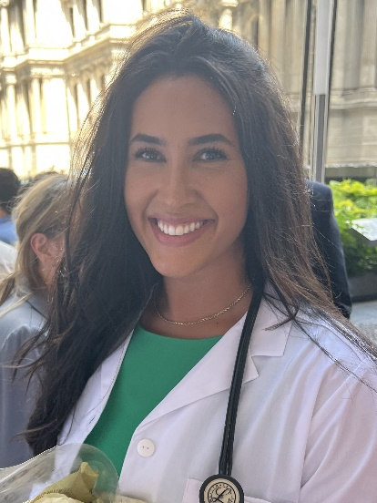
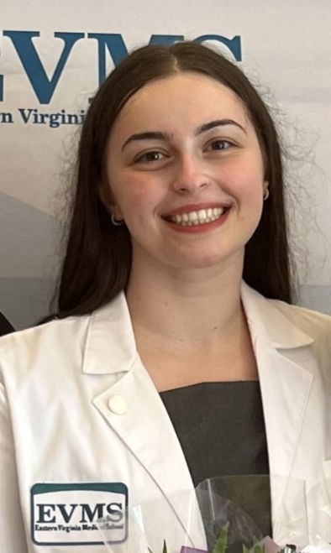
See your future?
Know your WHY!

Slide 5
KNOW YOUR WHY!
Each of your decisions can eliminate some possibilities, but each may also lead to new opportunities. Make choices that reflect and demonstrate why they are valuable to you. The best thing to do is always that for which we have the best reasons! Be sure your reasons are authentic, rooted in knowledge, and are well-conceived.

Slide 6
Today we will… …communicate our expectations for students seeking guidance, and those choosing to enter the upcoming application cycle, …preview the preparation required of you for both on-campus and professional school application processes, …provide overview of where you should be at this stage of consideration in the steps you are taking to seek a career in the health professions.

Slide 7
Lafayette College Advising Principles Cultivate in you, our students, how to research and use available resources independently to enable you to define your academic and personal goals. Are you ready to apply? Is your application strong and competitive? Who is your reference pool?

Slide 8
Consider Your Larger Timeline
1 20 40 60 80
1 2 3 4 5 6 7 8
4 years, 8 semesters, that shape your future!
Semesters 5 & 7 are pivotal.
From where have you come? How far will you go?
How have your expectations grown and changed while pursuing your education here at Lafayette College?

Slide 9
Undergraduate Preparation for Admission to Graduate
and Professional Schools in the Health Professions
You KNOW each school has its own criteria, but key to all are:
Academic/Science grades (major contributor)
Admissions tests (major contributor)
Health-related experiences
Research experiences
Community service and volunteer work
People skills & Humanist competencies
Letters of recommendation, HPAC, CLoE
HP school interview
While some criteria will be more variable than others, ALL remain important to those making admissions decisions; you will need to do more than say it, you need to SHOW and provide EVIDENCE of your resilience and durability in the face of challenges!

Slide 10
Undergraduate Preparation – Academic coursework
Required Undergraduate Coursework Check your bellwether schools
Typically required or strongly encouraged:
1 Year EACH of:
Biology with labs (e.g., 111 & 112)
Physics with labs (e.g., 111 & 112; 131 & either 132/133; 151 & 152)
Mathematics/Calculus/Statistics; minimally 1 calc + 1 stats
English composition/Writing-Intensive Coursework (1 or 2)
2+ Years of:
Chemistry with labs (Chem107/108; OCh 221/222) and Survey of Biochemistry (Chem 351)
Other frequently required or specialty required courses:
Sociology, Psychology, Bioethics; Microbiology, Nutrition, Genetics, Anatomy & Physiology or equivalent
~12-14 Core Courses needed; 1st semester juniors should have completed ~10-12 courses to stay on track; 1st semester seniors should have nearly all core requirements completed. Schools are increasingly preferring completion of ALL core courses AT APPLICATION, not upon matriculation!
EXPLORE course options in natural science, social science, humanities, and engineering divisions wherever possible!

Slide 11
Undergraduate Preparation – related considerations
If there is a reason to set aside an application, they will!
Advanced Placement. School scrutiny is rising! Be certain you are getting rigorous academic courses and laboratory training! Reduce/remove ambiguity in interpretations of your choices!
Summer Coursework, Pass/Fail, Light loads. Policies remain variable so try to limit vagueness or negative interpretations in your portfolio; elect full grading practice, complete challenging courses at home in full load.
Study Abroad. Request transcripts EARLY!!!
Research, Electives, Minors. Avoid appearance of trophy collection! Know why you seek these distinctions. Do that for which you have the best reasons!
Internships/Externships. Show your Depth, Breadth, Passion, Dedication! Push your boundaries and limits, stretch your comfort zone!
Extracurricular Activities. Focus on what you control NOW!
…and Read! Widely! Especially on healthcare. On policy. On current events. On music, theatre, sports, literature… See the HP Program website for suggestions.

Slide 12
Undergraduate Preparation – related considerations
If there is a reason to set aside an application, they will!
Advanced Placement. School scrutiny is rising! Be certain you are getting rigorous academic courses and laboratory training! Reduce/remove ambiguity in interpretations of your choices!
Summer Coursework, Pass/Fail, Light loads. Policies remain variable so try to limit vagueness or negative interpretations in your portfolio; elect full grading practice, complete challenging courses at home in full load.
Study Abroad. Request transcripts EARLY!!!
Research, Electives, Minors. Avoid appearance of trophy collection! Know why you seek these distinctions. Do that for which you have the best reasons!
Internships/Externships. Show your Depth, Breadth, Passion, Dedication! Push your boundaries and limits, stretch your comfort zone!
Extracurricular Activities. Focus on what you control NOW!
…and Read! Widely! Especially on healthcare. On policy. On current events. On music, theatre, sports, literature… See the HP Program website for suggestions.
If there is a reason to set aside an application, they will! Do not provide a reason! Reduce ambiguity in your portfolio!

Slide 13
Evaluating the avalanche of applicants with..
Interpersonal competencies: Service orientation, Social Skill, Culturally aware, Teamwork, Oral communication. COVID COMMENT: Seek out ACTIVE clinical engagement
Intrapersonal competencies: Ethical responsibility to self and others, Reliability and dependability, Resilience and adaptability, Capacity for improvement
Thinking and reasoning competencies: Quantitative reasoning, Critical thinking, Scientific inquiry, Written communication
Science competencies: Life systems, Human behavior
Anatomy of an Applicant Guide! By AAMC, but used universally! with developmental planning worksheets so you can gauge your performance! Click here!

Slide 14
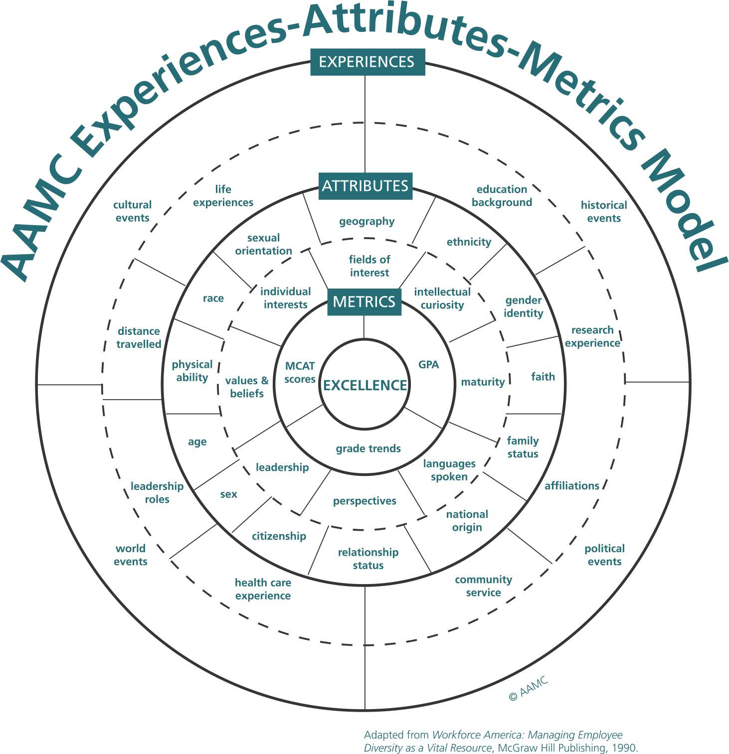

Slide 15
Application Components
Complete undergraduate coursework: core science, writing; Grades matter!
Select meaningful and diverse experiences; push your comfort zone; Be Active!
Pursue and understand meaningful research skills; Be able to relate!
Continue with service and extra-curricular involvement; Be dedicated!
Plan for expenses: $7500 on average per applicant for a full cycle; Be prepared!
Develop back-up plans 1, 2 and 3; Strengthen your portfolio!

Slide 16
Understanding Holistic Review
Useful in ‘first cut’ review for deciding/considering interview offers, HR places credentials of applicants contextually to life experiences; it insures applicants meet the school’s mission.
HR is NOT ‘robbing Peter to pay Paul’ nor ‘using an overflowing bucket to fill an empty bucket’…strong performance in some areas will NOT mitigate weak performance elsewhere.
“No one is saying that skills and inclination in science are not important,” Dr. Witzburg said. “But in this rapidly evolving and diverse society, they alone are insufficient.”
“I have a really strong application, except for…”
Do not fall into this trap and fallacy!
If there is a reason to set aside an application, they will!

Slide 17
How does this all fit together?
Academic credentials and course choices (AA)
Shadowing, clinical engagement, experiences (GCC)
Resources, organization, HPAC & application guidance (HPA)
Your complete, competitive portfolio, ready to apply!

Slide 18
Application Timeline Considerations
Our HP website timeline resource
For most applicants (and especially for medical schools) , the optimal time to apply to HP graduate school is in spring/summer of senior year, or within a year of graduating. This enables you to have amassed a competitive portfolio! The gap or growth year is now the ‘norm’ for MD and DO schools, PA programs and others. This poses added challenge for international student applicants. The smaller pool originally predicted with pandemic actually expanded by ~25% nationally. The most recent cycle shows a more typical application increase. Your disruptions are shared! You are not alone!
If your portfolio is competitive enough you must complete your application in spring/summer of junior year to enroll in the fall following graduation.
HP Advising works with you when you have all the components in place: completed science requirements; Admissions Test (MCAT, DAT, OAT, or VMCAT/GRE) on the horizon; a competitive profile of academic, research, health care experiences, extra-curricular accomplishments. Your application (letters of recommendation, HPAC interview, CLoE, etc.) will occur in spring semester of your application year…December to December to August matriculation! Again, schools are increasingly emphasizing completion of all core academic requirements before applying! Not by matriculation!

Slide 19
Your New Best Friends?
HP Advising Page and Gateway cc
Your 3 ‘Bellwether’ Schools (& MSAR?)
AAMC & AMCAS AACOM & AACOMAS
ADEA & AADSAS AACPM & AACPMAS
AAVMC & VMCAS ASCO & OptomCAS
AAPA & CasPA …and of course…
MCAT, OAT, DAT

Slide 20
Campus HPAC Application Timeline
1 2 3 4 5 6 7 8
Campus HPAC Application PRECEEDS school application
Highlights???
Complete your GreenSheet© advising/self-assessment
Provide your HP CV; schedule your GS Session with us
Solicit individual Letters of Recommendation
Draft Reflective Application Essay
Fill out your Personal Information Form
Interview with HPAC…
…THEN…Shift to your Application Portal!!

Slide 21
Summary Application Timeline
Refer to your HP Pre-Application Meeting Handout
To matriculate Fall 2025
-The process? A marathon…run like a sprint! Nearly 21 months!
-GreenSheet Form and HP CV submit by November 3 2023 to access our personal GS appointment evaluation sessions through Fall 2023
-Recommenders—WHO to recruit? 2 science faculty, 1 non-science faculty, 2 non-faculty supervisors…choose wisely! WHEN to ask? Before close of Fall 2023. HOW to request? A formal email asking for consideration and a meeting, providing drafts of materials attached with your request. WHAT to provide? Cover sheet dated 2024
-Draft your Reflective Personal Statement Essay; complete your PIF
-Establish your exam preparation schedule…and adhere to it
-FIRST DEADLINE 1 February 2024: Provide to HPA your HP Advising Waiver Form (may require Dean’s meeting for follow-up)
-SUPER DEADLINE 1 March 2024: Provide to HPA ALL Letters of Recommendation with ratings and counter-signed cover sheet; PIF, updated HP CV, Reflective Personal Statement Essay

Slide 22
Summary Application Timeline
Refer to your HP Pre-Application Meeting Handout
-HPAC On-Campus Interview invitations are extended with HPAC sub-committees through March and April 2024 (see last slide!)
-Sit for Examination by May 2024 to have scores by 1 June 2024
-Create your account with your CAS when application services open in Spring 2024; you need a month to populate from your PIF/HP CV
-Manage your TRANSCRIPTS following CAS policies asap; wait for your LC transcripts until Spring 2024 grades are available
-2^{ndary} requests extended, sometimes after previews, sometimes automatically, but finish them within a week of receipt!
-School interviews initiated in late July 2024 and may continue through March 2025; interviews may be in person, virtual or MMI
-Admission offered perhaps within 3 weeks or as long as 6 months, but October 15 2024 is earliest acceptance date; waitlist use varies
…so maybe you can see why the mean age of matriculating
HP students has increased to 25!

Slide 23
Employing the GAP year(s) effectively
What should I do? Assess your portfolio REALISTICALLY…
Your goal? Apply at maximum competitiveness!
How? Fill in the gaps!
Enhance and focus!
Be creative and innovative!
Push beyond your comfort zone!
Is a Post-Bac Program a good fit? They are HIGHLY variable
With a gap year, you defer entry into on-campus HPAC application cycles until your senior year or thereafter; the process then runs in normal sequence for secondaries, interviews…and acceptance?!?!?
…But stay connected so you do not miss meeting on-campus deadlines! Update your materials so HP Advising can assist!

Slide 24
Your To-Do List …
Set SMART goals:
Specific
Measurable
Achievable
Realistic
Timely
Track your completed coursework
Review data at professional society and Bellwether school webpages
Attend HP Sessions and Gcc events
Manage your commitments

Slide 25
What does EVERY aspiring HP student need?
External feedback that is
-compassionate
-informed
-constructive
Internal Self-Assessment that is
-courageously honest
Can I do, can I be better?

Slide 26
Upcoming and On the Horizon?
From HPA…
Mandatory Application Info Session, November 1, 2023
Peer editing workshop for Personal Statements Jan/Feb 2024
How to manage your growth year(s) Spring 2024
…And…
AAMC Great Group: Tips for applying to graduate school Oct 10, 2023
MCAT Examinee Webinar Oct 12, 2023
LC Pre-Dental Society Programs Oct 12 and 18, 2023
AAMC Virtual Medical School Fair, Oct 17-18, 2023
All of us at Lafayette College look forward to your success as you plan for a career in the health professions. Follow our Twitter account @HPLafCol, connect with Gateway Career Center, and visit us at http://healthprofessions.lafayette.edu/

Slide 27
About Admissions Tests Competitive Targets…
MCAT https://www.aamc.org/students/applying/mcat/
Biological and Biochemical Foundations of Living Systems
Chemical and Physical Foundations of Biological Systems
Critical Analysis and Reasoning Skills
Psychological, Social & Biological Foundations of Behavior
Target: 510 (80th %ile) and GPA 3.6+
DAT http://www.adea.org/dental_education_pathways/aadsas/Applicants/Pages/TaketheDAT(DentalAdmissionTest).aspx
Natural Science (biology, general and organic chemistry)
Perceptual ability (2- and 3-dimensional problem solving)
Reading comprehension
Quantitative reasoning
Target: 20-21 (75th %ile) and GPA 3.6

Slide 28
…targets continued…
OAT https://http://www.ada.org/en/oat
Natural Sciences (Biology, Gen Chem, Organic Chem)
Reading Comprehension
Physics
Quantitative Reasoning
Target: 350 (75th %ile) and 3.5 GPA
GRE- General Test, Subject Tests http://www.ets.org/gre/revised_general/about/?WT.ac=grehome_greabout_a_150213
Verbal Reasoning
Quantitative Reasoning
Analytical Writing
Biology (CMB, Organismal, EE)
Biochemistry, Cell and Molecular Biology
VET and PA Target: ~155-160 (70th%ile) and 3.4-3.8 GPA
…budget ~500 hours (2-3 college courses) to prepare

Slide 29
Listen to what your data are telling you…
Applicant Matriculation Year | Acceptance GPA 3.60+ | Acceptance GPA 3.59-3.20 | Acceptance GPA <3.20 | Acceptance Overall
Lafayette 2018-2022 Aggregate data (MD + DO) | 72% | 46% | 25% | 64%
National 2020-2023 (MD only) | 53% | 28% | 13% | 41%
2018-2022 64% medical school applicants were accepted 89% dental school applicants were accepted 100% veterinary school applicants were accepted 100% optometry applicants were accepted Data for DP, PA, MPH and other allied health specialties are not yet available.
Gaining Admittance Is Increasingly Challenging! Be Prepared!
* Source: aamc.org, aacomas.org

Slide 30
Thank you!
Questions?

Slide 31
Financial Components of a Successful Application
TESTING FEES (scores reported as soon as instantly to 4 weeks depending):
MCAT $335 ($445, $150)
DAT $525
OAT $465
GRE general $228
GRE subject test fees $150
PREview® TEST $100
CASPer test $10 + $10x/school
PRIMARY APPLICATION FEES (Secondary fees, College Service fees additional)
AMCAS $170+ $43
AACOMAS $198 + $55
ADEA AADSAS $264 + $115
OptomCAS $185 + $75
VMCAS $227 + $124
AACPMAS $200 + $65
CASPA $184 + $61

Slide 32
Is financing part of the equation and your decision? Maybe it should be!
Application cycle expenses: $7400
Median cost for 4 years of HP school:
$278,455 (private) or $207,868 (public)
Median debt for 4 years of HP school:
$174,000
Federal loans: 6.8-7.9%
Undergraduate added indebtedness: $29,400
Residency training salaries: annual average is
$55,300 for 3+ years, so an added debt load of ~$30,000 yearly
…watch for CAS programming on this!

Slide 33
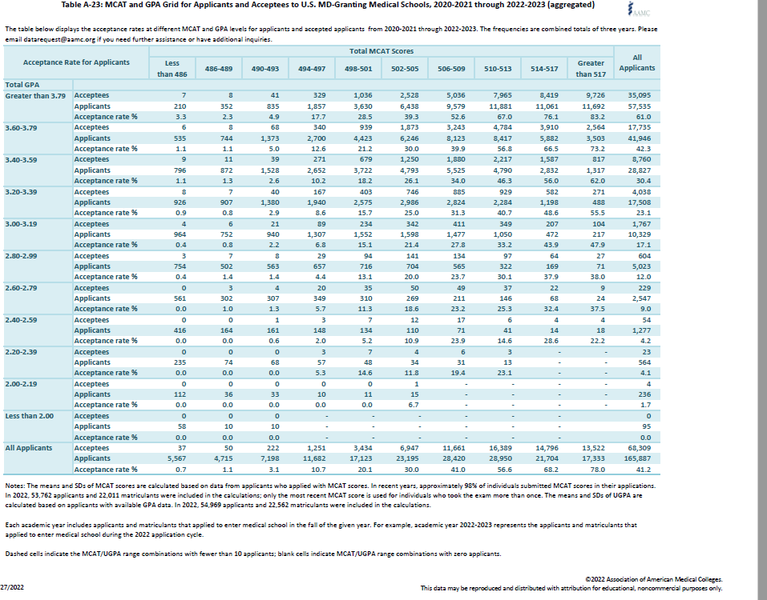
EXAMPLE: AAMC Aggregate MCAT and GPA Data
Source: AAMC Table A-23
https://www.aamc.org/media/6091/download?attachment

Slide 34
Listen to what your data are telling you…
 | Applicants 2020-2021 | Matriculants 2020-2021 | Applicants 2021-2022 | Matriculants 2021-2022
MD 16/appl | 506.4 3.6 53,030 | 511.5 3.73 22,239 | 505.9 3.48 62,443 | 511.9 3.74 22,666
DO 12/appl | 502.8 3.58 27,277 | 504.6 3.56 8,516 | n/a | n/a
Dentistry | 19.1 3.45 11,759 | 20.4 3.59 6,295 | n/a | n/a
Veterinary, optometry and podiatry data are not yet available
Needs to be upated with data!
Consider this: from MD applicants with GPA 3.8-4 & MCAT 518-528, 87% get accepted…but 13% do not! 1 in 8 rejected!
* Source: 2018-2020 aamc.org, aacomas.org

Slide 35
“Things I wish I had known/done…”
-STUDIED available online resources! MSAR, HPAC handbook, links, etc!
-PREPARED BETTER for admission tests
-PRACTICED interviews, REVIEWED questions, READ more
-OWNED my personal choice of schools; ASKED myself the “ONLY” question!
-HONESTLY assessed my application; NOT “Except for xxxx, my app is good.”
-Thought more STRATEGICALLY

Slide 36
HPAC?? Health Professions Advisory Committee faculty and staff who review student applications to medical, dental, optometry and veterinary schools Chaired by Professor Waters, Biology, RISC 218 with faculty from across campus who review, interview and recommend student and alumni applicants Mrs Glaus, Director, HP Advising, Scott Hall 101 Ms Schultz, Senior Associate Director, Gateway, Hogg 201 …along with the Office of HP Advising, HPAC contributes to sources of programming for advising, career exploration, internships, externships, off-campus resources and more! It is up to YOU to access these resources!

Slide 37
Academic Integrity and Conduct Violations
Practice Principles of Intellectual Honesty: Make judicious choices in your behavior! Assume the consequences of your actions!
Exhibit high personal standards of ethics and deportment. Exercise sound judgment. Students who lack high standards of character and integrity, either in academics (cheating, plagiarism) or in personal behavior (alcohol, drugs, vandalism, etc.) risk being eliminated as applicants… especially if they fail to own up to them!
The application process requires that the Dean of Advising report any disciplinary action to the HP schools where you seek admission. Problems arise when what is reported differs from what you disclose. Graduate schools also do background checks for off-campus violations. HP can help you contextualize your experiences.

Slide 38
…and another thing about conduct…
Etiquette and Manners Matter
Do YOUR homework first. sometimes it does hurt to ask!
Address persons with respect; use their titles.
Treat e-mail as formal correspondence—faculty treat it as such! Grammar and spelling matter!
Introduce yourself; Provide complete information, specific context (subject header? context? email signature? relevant attachments?)
Request, rather than demand or instruct.
Provide sufficient advance notice.
Always say ‘Thank you!’ and mean it!

